Slide 1


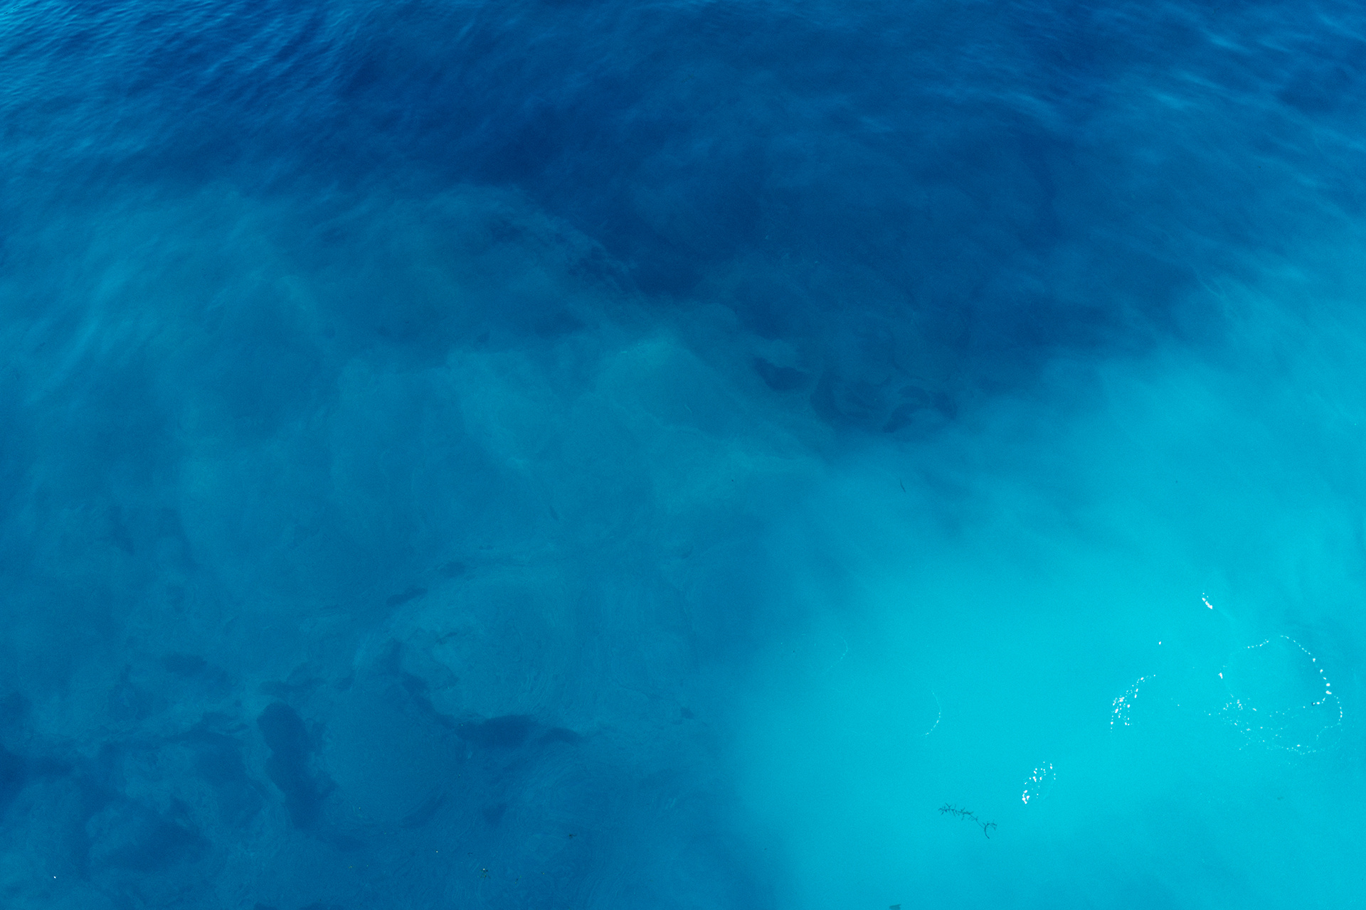




SAVING LIVES AT SEA, ONE WEATHER PREDICTION AT A TIME
© By StormByte

Slide 2

Introduction
OceanSafe is a real-time ocean safety and activity planning application designed to help users make informed decisions about ocean-based activities. Built for the NASA Space Apps Challenge 2025, it combines real-time ocean data, weather monitoring, and AI-powered safety recommendations to ensure safe and responsible ocean exploration.

Slide 3
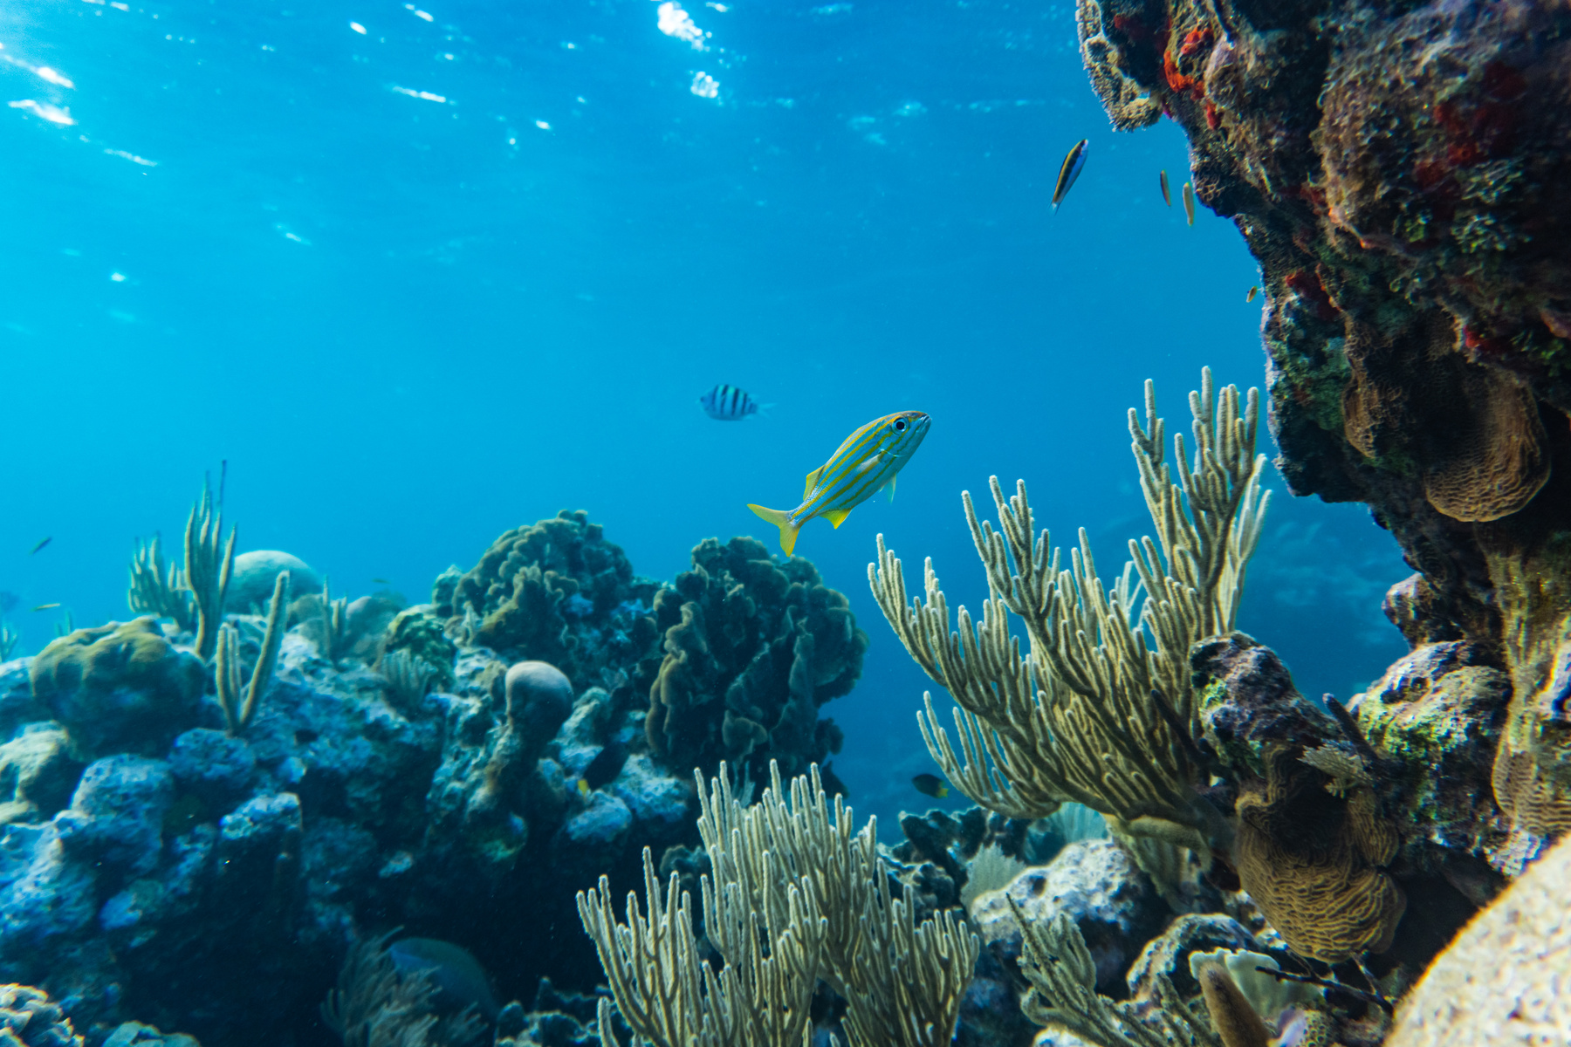

Current Problem
You check your phone's weather app
It says: "Partly cloudy, 22°C, light rain possible"
But it doesn't tell you:
How high are the waves?
Is the wind too strong for my boat?
Are ocean currents dangerous today?
Can I see clearly at sea?
Should I stay home or is it safe?
Our Solution: OceanSafe

Slide 4
Solutions
Real-time sea data
Safety alerts
User-friendly dashboard
Provide wave height, wind speed, currents, and visibility updates using marine sensors and APIs.
Notify users when sea conditions are too dangerous for boating or fishing.
Provide wave height, wind speed, currents, and visibility updates using marine sensors and APIs.
Forecasting
Mobile and web access
Show sea conditions on a simple, visual map similar to Google Maps.
Offer short-term forecasts (hours or days) for waves, wind, and currents.

Slide 5
TOOLS
Frontend
Backend
React + TypeScript
Supabase
Tailwind CSS
NASA APIs
Lucide Icons
OpenStreetMap Nominatim
Real-time Updates

Slide 6
Impact of our project
Improves safety by warning about dangerous marine conditions
Helps fishermen and sailors plan trips efficiently
Saves time and fuel by avoiding bad weather
Supports better decision-making for maritime activities
Provides real-time, reliable information for users
Promotes responsible and safer use of the sea

Slide 7




Future Enhancements
AI-Powered Predictions
Offline Mode
Multilingual Voice Alerts
Community Reporting
Integration with Smart Devices

